Slide 1
The State of the Shell
The PowerShell Team

Slide 2
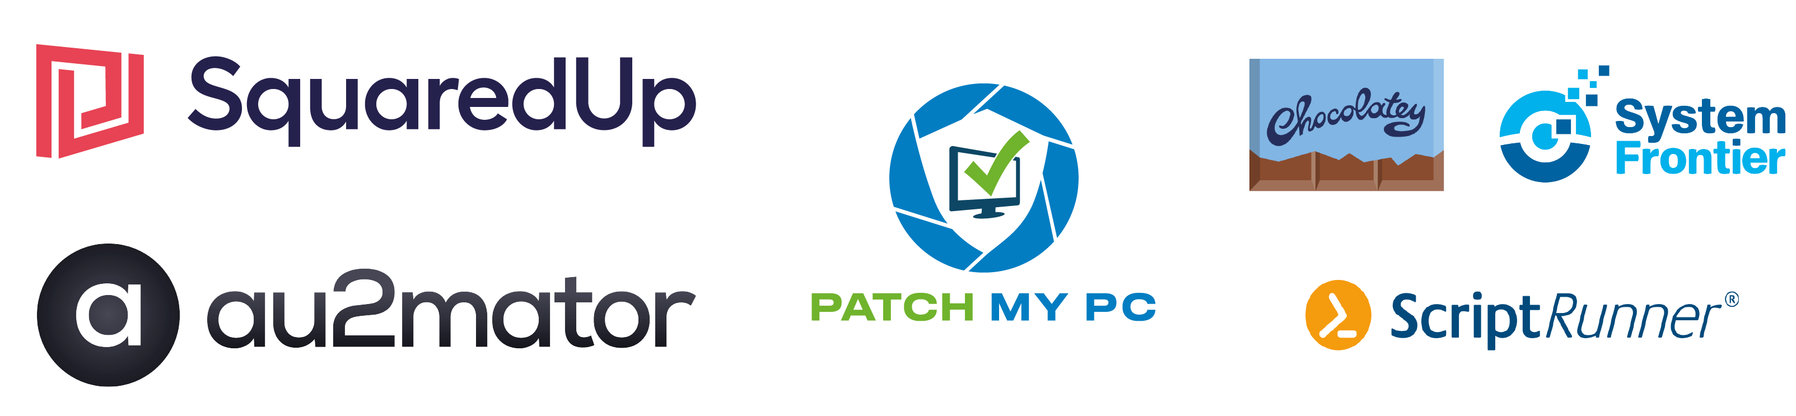
Many thanks to our sponsors:

Slide 3
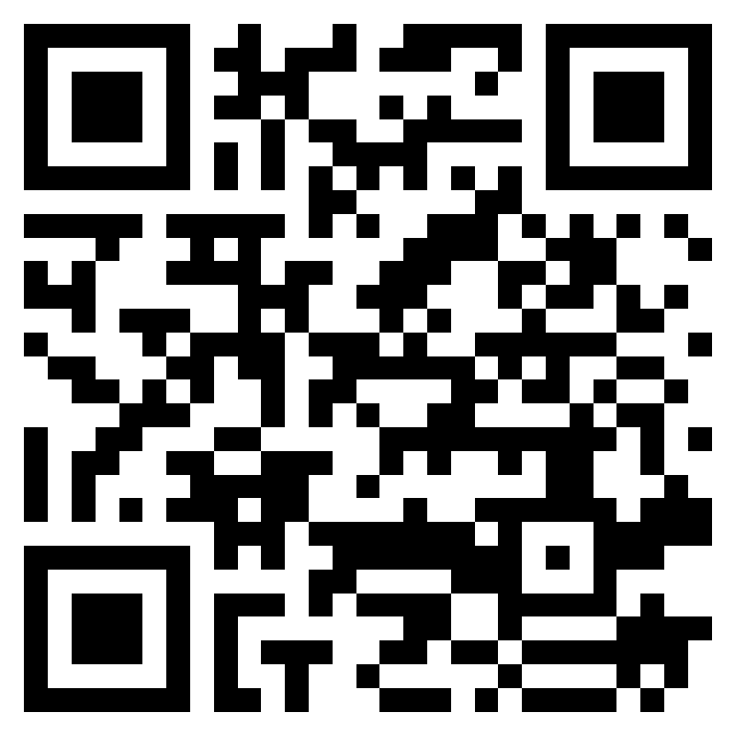
Community Demo

Slide 4



Slide 5
Agenda
Today the world is a messy place
The world has always been a messy place
In the past, PowerShell helped by simplifying automation
PowerShell continues to help by simplifying automation
A lot of life improving stuff has shipped the last three years…
And you’ve solved problems with it…
PowerShell is as relevant than ever (because pandemics are messy)
And new features can help with shifting problems

Slide 6
We Missed You!

Slide 7

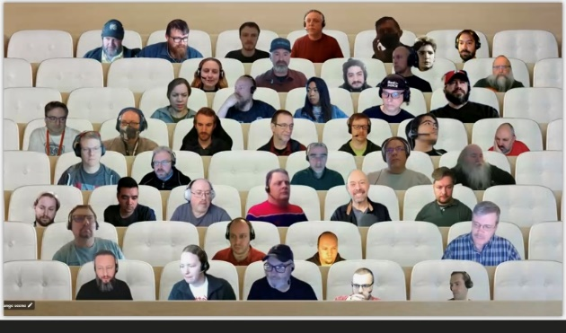





Slide 8

Every time I take a step …
Too many distributions
Too many breaking changes
Too many dissimilar services
Too many interfaces
Too many management tools
Too many changing requirements

Slide 9
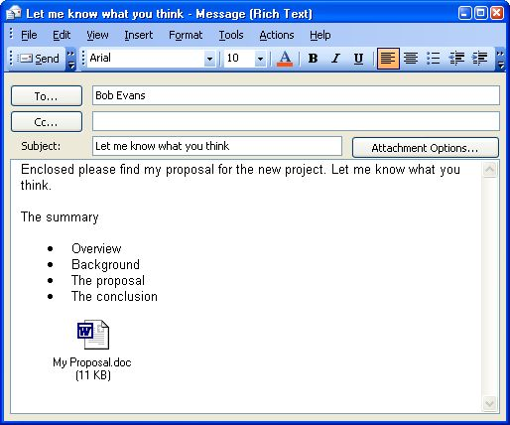






This is an old problem

Slide 10
Monad Manifesto
“Monad leverages the .NET Common Runtime to provide a powerful, consistent, intuitive, extensible and useful set of tools that drive down costs of administration and make the life of non-programmers a lot easier”
http://www.jsnover.com/Docs/MonadManifesto.pdf

Slide 11
“Learn PowerShell and we’ll do everything we can to make it the best investment you’ve ever made.” – Jeffrey Snover
It isn’t just a promise.
It’s the continuous effort, engaging with the community, to grow and extend PowerShell to serve the needs of operations.

Slide 12
Improve the lives of folks working on operations by simplifying automation.

Slide 13
Improve the lives of folks working on operations by simplifying automation.
We have genuine empathy for our users.
The world is continuously changing.
PowerShell should relieve this frustration.

Slide 14
Improve the lives of folks working on operations by simplifying automation.
PowerShell users solve diverse problems. PowerShell is for everyone who does operations. PowerShell is all about the users and the problems they solve.

Slide 15
Improve the lives of folks working on operations by simplifying automation.
PowerShell relieves fear over unfamiliar technology because the process of learning new types of automation is consistent with the past.
PowerShell continues to evolve with its community.

Slide 16




Improve the lives of people working on operations by simplifying automation.
Welcome diverse new uses/users
Reduce friction for users adopting new technologies
Build on legacy of customer trust
Engineer for Agility
PowerShell should make you more valuable over time (Sacred vow)
The world is a messy place
When you do impactful work at scale, mistakes matter
The world changes quickly, and the challenges are immediate.

Slide 17
What we have been up to the last 3 years
Welcome diverse new uses of PowerShell
PowerShell in Azure Functions
ForEach–Object –Parallel
Improvements in Windows/Linux Container images
PowerShell support for notebooks
Visual Studio Code for PowerShell 7
Console Gui tools (ConsoleGridView)
PowerShell user group videos
Additional distro support for PowerShell
104 active GitHub projects
New ErrorView
New operators (ternary, pipeline chain, null conditional)
ANSI colors with $PSStyle
Reduce friction for users adopting new technologies
Cloud Shell Enhancements
PSSA compatibility rules
DSC Resource Kit
Cloud Shell support for Exchange Online
Out-GridView for PS7
ISE Mode for Visual Studio Code
PowerShellGet 3.0 (previews)
PowerShellGetCompat module (preview)
Crescendo (previews)
PlatyPS
Predictors
WindowsCompat layer
Shipping w/ .NET release cadence
Microsoft Update support
Build on legacy of user trust
PowerShell Gallery accessibility work
PowerShell release improvements
PowerShell editor service release improvements
Improved testing for PowerShell extension for Visual Studio Code
SecretManagement
SecretStore
Executive Order Requirements (+ many more compliance reviews/requirements)
PowerShell Gallery (and PowerShellGet) TLS changes
Monthly community call
SSH based remoting
Engineered for Agility
60+ releases of PowerShell (preview and stable) since May 2019

Slide 18
What we have been up to the last 3 years
Welcome diverse new uses of PowerShell
PowerShell in Azure Functions
ForEach–Object –Parallel
Improvements in Windows/Linux Container images
PowerShell support for notebooks
Visual Studio Code for PowerShell 7
Console Gui tools (ConsoleGridView)
PowerShell user group videos
Additional distro support for PowerShell
104 active GitHub projects
New ErrorView
New operators (ternary, pipeline chain, null conditional)
ANSI colors with $PSStyle
Reduce friction for users adopting new technologies
Cloud Shell Enhancements
PSSA compatibility rules
DSC Resource Kit
Cloud Shell support for Exchange Online
Out-GridView for PS7
ISE Mode for Visual Studio Code
PowerShellGet 3.0 (previews)
PowerShellGetCompat module (preview)
Crescendo (previews)
PlatyPS
Predictors
WindowsCompat layer
Shipping w/ .NET release cadence
Microsoft Update support
Build on legacy of user trust
PowerShell Gallery accessibility work
PowerShell release improvements
PowerShell editor service release improvements
Improved testing for PowerShell extension for Visual Studio Code
SecretManagement
SecretStore
Executive Order Requirements (+ many more compliance reviews/requirements)
PowerShell Gallery (and PowerShellGet) TLS changes
Monthly community call
SSH based remoting
Engineered for Agility
60+ releases of PowerShell (preview and stable) since May 2019

Slide 19
What you have been up to…

Slide 20
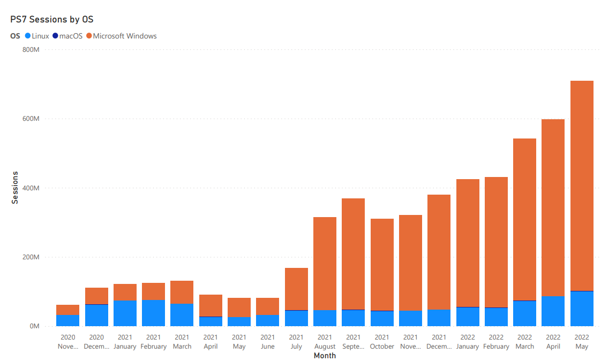
What you have been up to
708M

Slide 21
What you have been up to
708M

Slide 22
What you have been up to
708M

Slide 23
What you have been up to
708M

Slide 24
What you have been up to
16 Trillion Cmdlets ran in 2021
Over 3 billion downloads from the PowerShell Gallery since spring 2019 (currently avg 50 million weekly downloads)
Over 400 million unique instances of PowerShell 7 in 2021
64% on Linux
Over 2.5 billion starts of PowerShell 7 in 2021
Over 350,000 monthly users of the PowerShell extension for VSCode
Over 10% on macOS

Slide 25
What you have been up to
Across all PowerShell Org Repos 2016-2022
Over 23k issues created
Over 17k PRs Created
In 2021…
~40% of all PRs in PowerShell were community
Over 600K unique posts mentioning PowerShell
Over 1 Billion people reached

Slide 26
What we are working on
Welcome diverse new uses of PowerShell
Additional Azure Mariner support
PowerShell 7 in Windows exploration
macOS Notarization support
More Windows ARM64 support
ANSI coloring
OpenSSH for Windows
Predictive Intellisense
CompleterPredictor
Az Predictor
Crescendo
Reduce friction for users adopting new technologies
Move PowerShell to .NET 7
Making it easier to find out what’s new in PowerShell
Custom ConnectionInfo
Local SessionConfiguration support
Module Isolation
PlatyPS 2
PowerShell extension for Visual Studio Code stability and performance improvements
PowerShellGet 3.0
PSDesiredStateConfiguration 3.0
Build on legacy of user trust
AMSI and WDAC enhancements
Continued work on executive order requirements
Compliance commitments
PowerShell Gallery scale improvements
Engineered for Agility
Working groups/supporting open source
Continued investments in test and release infrastructure
https://devblogs.microsoft.com/powershell/
https://aka.ms/PSYouTube

Slide 27
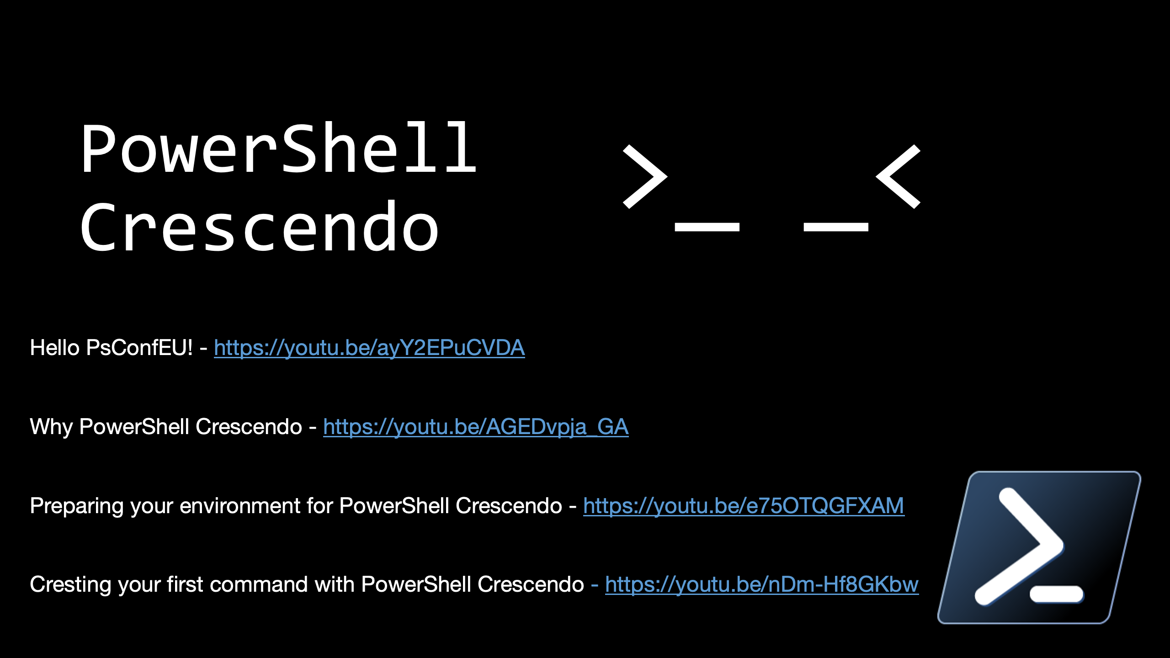

Slide 28
We’ll be here all week…
Mon 4:00pm-4:45pm What is going on with PowerShellGet v3
Tues 3:00pm-3:45pm PowerShell Predictors
Wed 9:00am-9:45am SecretManagement (Getting Started)
Wed 2:00pm-2:45pm Let's Talk about Guest Configuration*
Thursday 2:00pm-2:45pm Reverse ask the expert with the PowerShell team

Slide 29

Thank you!
Enjoy the conference!
Get PowerShell: https://aka.ms/Get-PowerShell
Stay in Touch!
PowerShell GitHub
www.github.com/powershell
PS Community Call – 3rd Thursday of every month
www.aka.ms/joinPSCall
PowerShell Team Blog
https://devblogs.microsoft.com/powershell
PowerShell Team Twitter
https://twitter.com/PowerShell_Team

Slide 30
Even more repos…
PowerShell Completion Predictor for PSReadLine Predictive IntelliSense
https://github.com/PowerShell/CompletionPredictor
Unix Tab Completions - PowerShell parameter completers for native commands on Linux and macOS.
https://github.com/PowerShell/UnixCompleters
Get-WhatsNew - Cmdlet that provides information about changes and new features
https://github.com/PowerShell/whatsnew
DSC v3 beta1 – A Platform that enables writing configuration as code
https://github.com/PowerShell/psdesiredstateconfiguration

